Slide 1
DS 201 Final Project
Heart Disease
by
No Group Name
Haoyu Li, Sijie Huang, Yu Hong, Yijia Sun

Slide 2
Part 1: Ask a question
Our dataset
Heart disease data from UCI datasets repository
Variables include:
age (age of an individual)
sex (male or female)
cp (chest pain type)
trestbps (resting blood pressure)
chol (serum cholesterol)
fbs (fasting blood sugar)
restecg (resting electrocardiographic results)
thalach (maximum heart rate)
exang (exercise induced angina)
oldpeak (ST depression induced by exercise relative to rest)
slope (slope of the peak exercise ST segment)
ca (number of major vessels colored by fluoroscopy)
thal (heart defect)
target (whether an individual has heart disease)

Slide 3
Part 1: Ask a question
The questions/answer we expect to find
By analysing the data, to find:
The correlation between factor of heart disease
The cause lead to heart disease
Through selecting efficient Machine Learning, to predict:
The likelihood of having a heart disease

Slide 4
Part 1: Ask a question
The benefits
The results of this project can:
Be applied in the medical industries for research and curing purpose
Educate people more knowledge of heart disease with scientific aspect
Alarm people how to prevent and detect heart disease

Slide 5


Part 2: Get the Data
Data collection
From the UCI Machine Learning Repository
Data clean and preparation
Variables were selected or removed through resources learning (two articles + one website)
age
sex
ca
cp
trestbps
chol
Change Category variable represented by number into word
thalach
exang
slope
restecg
target
fbs
oldpeak
thal
Notes:
To screen out the data for effective analysis, we referred some resources online to define the major factors of heart disease.
The two variable selected first in accordance with Mahmood & Kuppa’s study in 2010 (Biomarkers of heart disease):
ca (number of Major Vessels Colored by Fluoroscopy
cp (Chest Pain Type)
Category variable into num
Variables selected according to Mayo Clinic’s website (Key factors to identify heart disease):
trestbps (resting blood pressure)
chol (serum cholesterol)
thalach (maximum heart rate)
exang (exercise induced angina)
Variables selected from Okin & Kligfield’s study in 1995 (slope and heart rate can improve the accuracy of the electrocardiogram results for identification of patients with coronary artery disease):
slope (slope of the peak exercise ST segment)
thalach (maximum heart rate)
restecg (resting electrocardiographic results)
We didn’t use the Fasting blood sugar (fbs) as one of the variables because it’s not the major factors result in the heart disease
We didn’t use the ST depression induced by exercise relative to rest (oldpeak) as one of the variables is because it’s influenced by the slope of the peak exercise ST segment and the heart rate, which are the variables we’ve already selected.
We didn’t use the heart defect (thal) as one of the variables because it’s a type data, which is unclearly defined by number in this dataset.

Slide 6
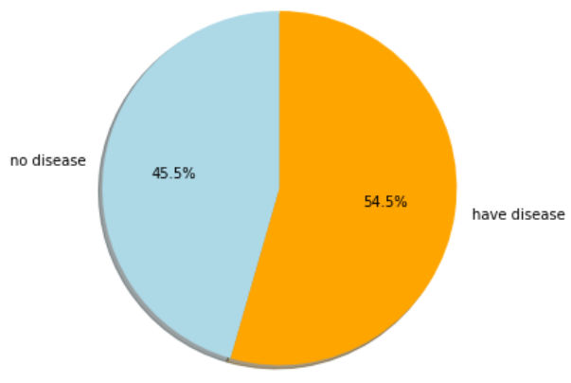
Part 3: Explore the Data
Visualization

Slide 7
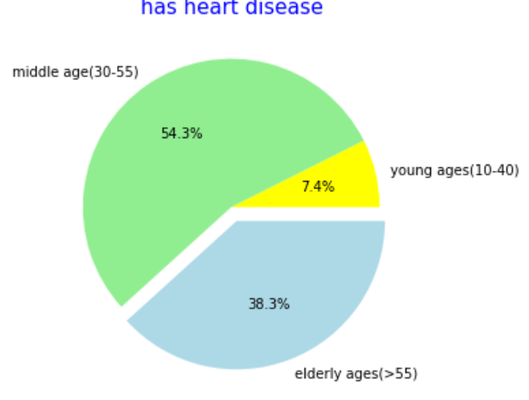
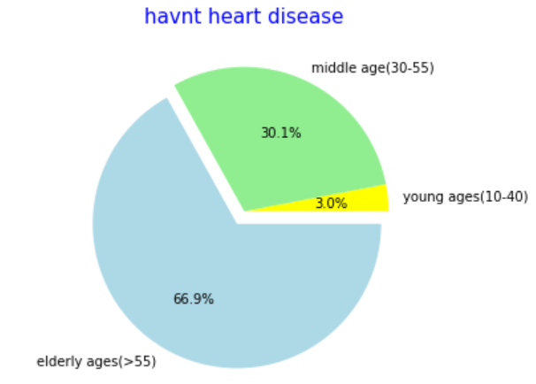
Part 3: Explore the Data
Visualization

Slide 8
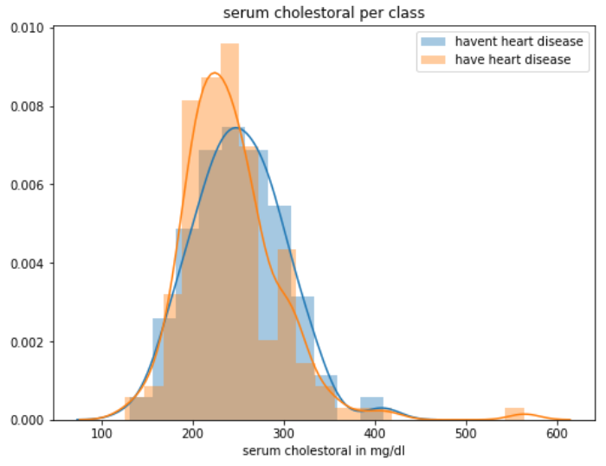
Part 3: Explore the Data
Visualization

Slide 9
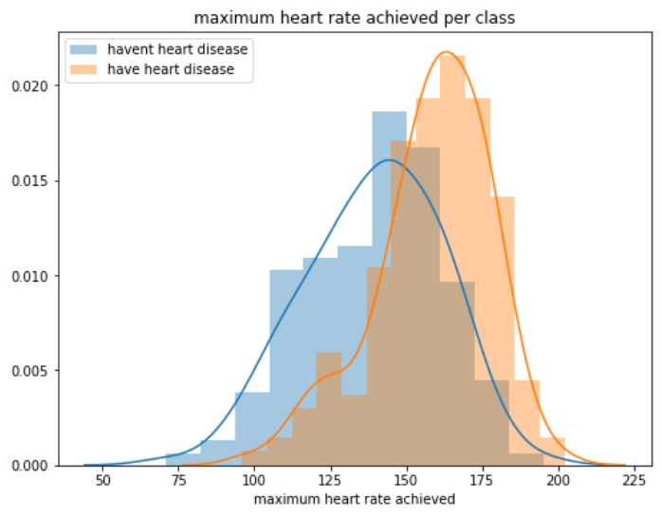
Part 3: Explore the Data
Visualization

Slide 10
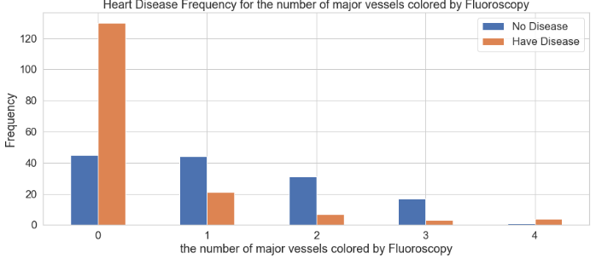
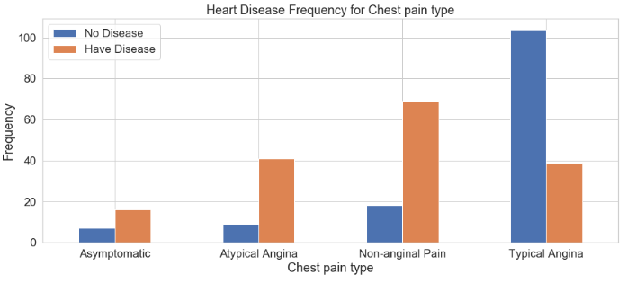
Part 3: Explore the Data
Visualization

Slide 11
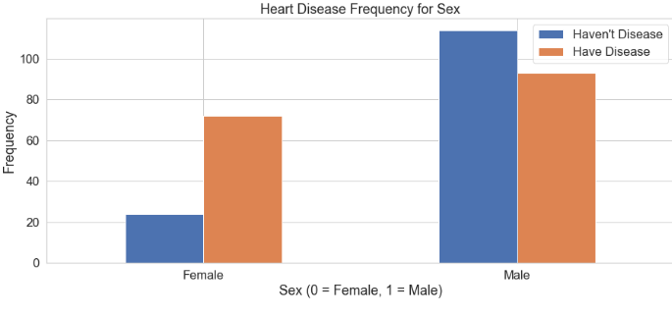
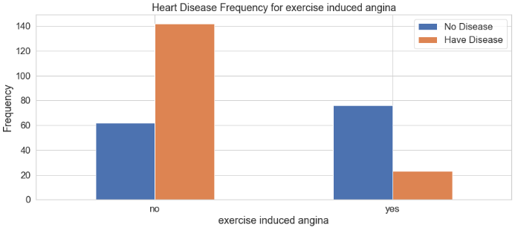
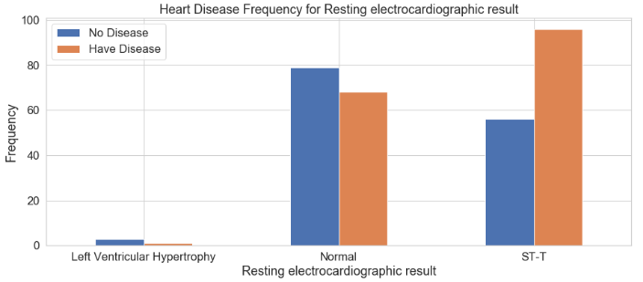
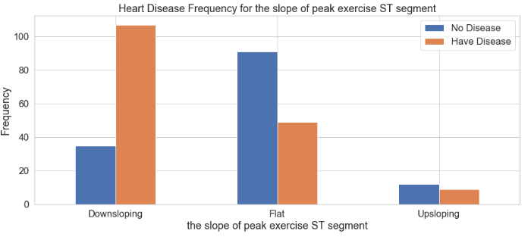
Part 3: Explore the Data
Visualization

Slide 12
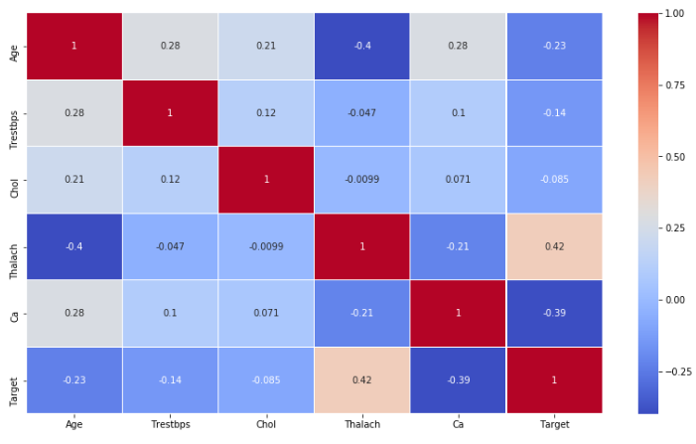
Part 3: Explore the Data
Visualization

Slide 13
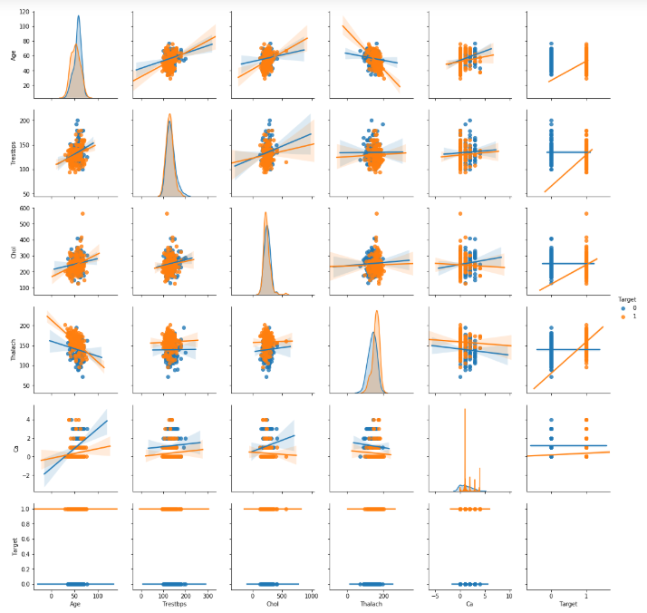
Part 3: Explore the Data

Slide 14

Part 3: Explore the Data
Data improvement
More data (major factors) need for making prediction more precise
Data type should be clarified (e.g. heart defect)
Notes:
Major factors: The factors directly result in the heart disease.
Heart defect is defined into different types of defect, numerical level is not a good identification (from online resources).
We change the categorical data into dummy variable.

Slide 15
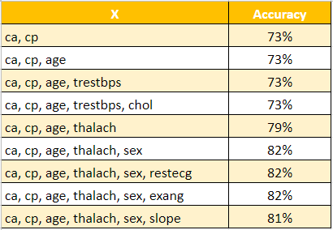
Part 3: Model the Data
Machine Learning
Logistic Regression

Slide 16

Part 3: Model the Data
Machine Learning
Logistic Regression

Slide 17
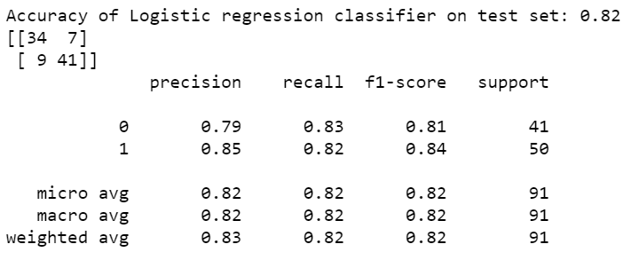
Part 3: Model the Data
Machine Learning
Logistic Regression

Slide 18
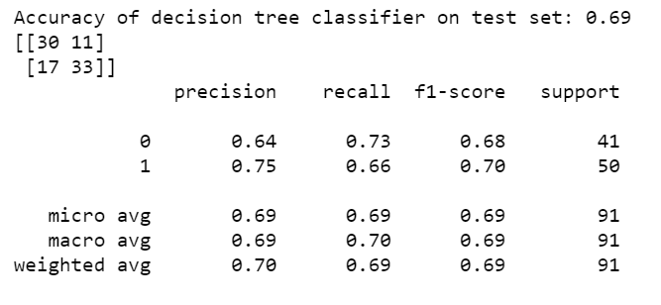
Part 3: Model the Data
Machine Learning
Decision Tree

Slide 19
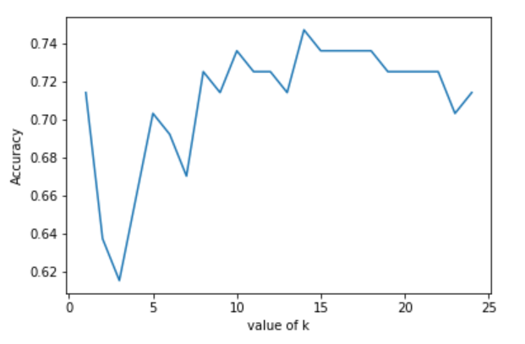
Part 3: Model the Data
Machine Learning
KNN
Find the best k
Notes:
k=14

Slide 20
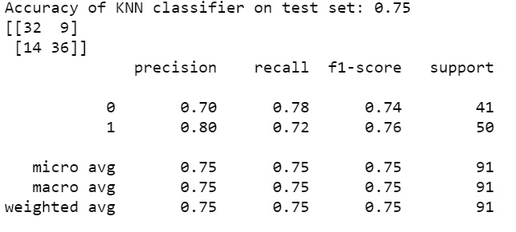
Part 3: Model the Data
Machine Learning
KNN

Slide 21
Sources/References
Mahmood, A. M., and Kuppa, M. R., (2010, December). Early Detection of Clinical Parameters in Heart Disease by Improved Decision Tree Algorithm. In 2010 Second Vaagdevi International Conference on Information Technology for Real World Problems. pp. 24-29. IEEE.
Okin, P.M., and Kigfield, P. (1995). Heart rate adjustment of ST segment depression and performance of the exercise electrocardiogram: a critical evaluation. Journal of the American College of Cardiology. 25(7), pp 1726-1735.
UCI Machine Learning Repository: https://archive.ics.uci.edu/ml/datasets/Heart+Disease

Slide 22

Thank you!
Any question?

